Slide 1

Conditionals and Loops

Slide 2
If Statement
Execute a certain block of code only if a certain condition is true

Slide 3
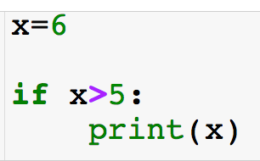
If Statement
Execute a certain block of code only if a certain condition is true
Conditional: must return boolean
If statements always begin with an “if”

Slide 4
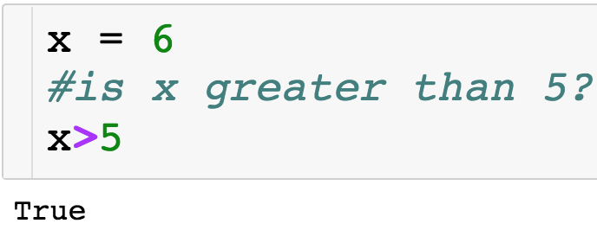
If Statement
Execute a certain block of code only if a certain condition is true
Conditional: must return boolean
If statements always begin with an “if”

Slide 5
If Statement
Execute a certain block of code only if a certain condition is true
Conditional: must return boolean
“:” ends statement
If statements always begin with an “if”

Slide 6
If Statement
Execute a certain block of code only if a certain condition is true
Conditional: must return boolean
“:” ends statement
If statements always begin with an “if”
If condition is true, then indented line of code will run

Slide 7
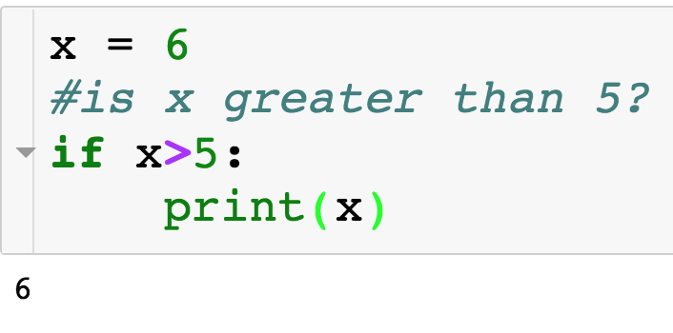
If Statement

Slide 8
If + Else Statement
Else statement allows us to specify separate directions if the condition with the if is False.

Slide 9
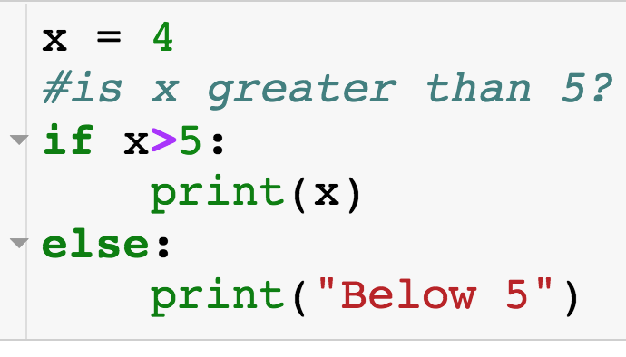
If + Else Statement
Else statement allows us to specify separate directions if the condition with the if is False.
Else always executes when the if condition is False.
Match if + else by indentation
Else is optional, meaning an if statement doesn’t have to have an accompanying else.

Slide 10
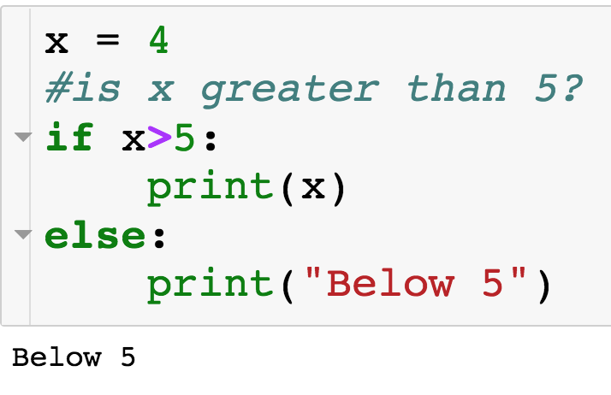
If + Else Statement
If condition is False, so code inside of else executes

Slide 11
If + Elif + Else Statement
How do I specify multiple conditions?...

Slide 12
If + Elif + Else Statement
How do I specify multiple conditions?...elif

Slide 13
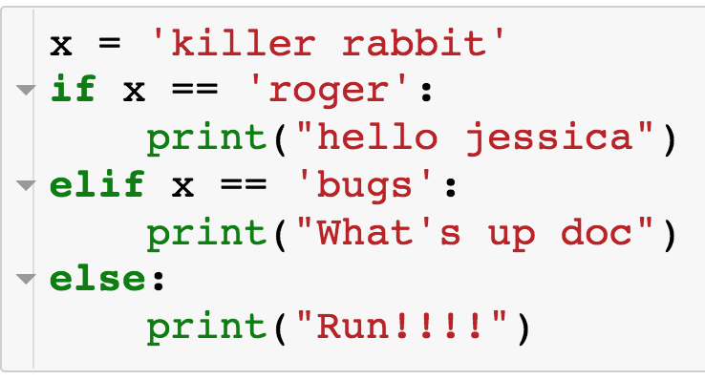
If + Elif + Else Statement
How do I specify multiple conditions?...elif
Comes between if and else
Can have arbitrary number of elifs
First if/elif condition that is true is executed and only this block is executed
If no if/elif condition is true then else is executed
Indentation matches up if/elif/else statements

Slide 14
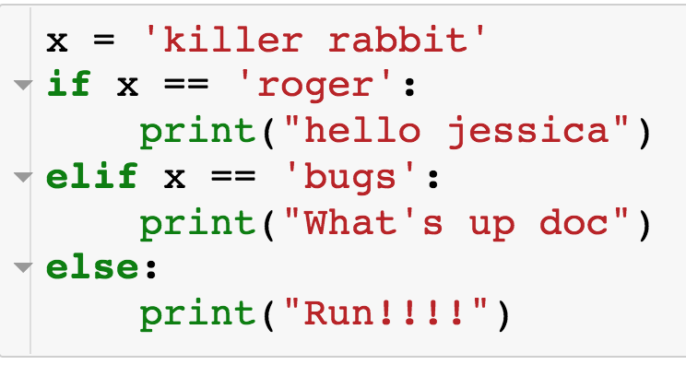
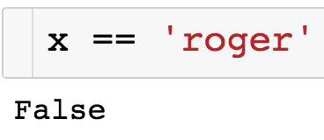
If + Elif + Else Statement

Slide 15
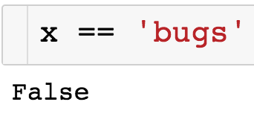
If + Elif + Else Statement

Slide 16
If + Elif + Else Statement
Since all if/elif conditions were False, else statement executes

Slide 17
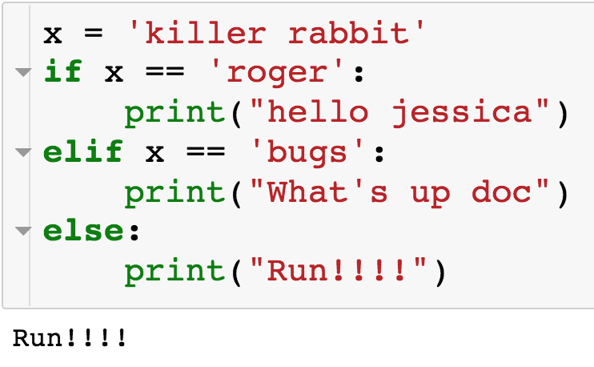
If + Elif + Else Statement

Slide 18
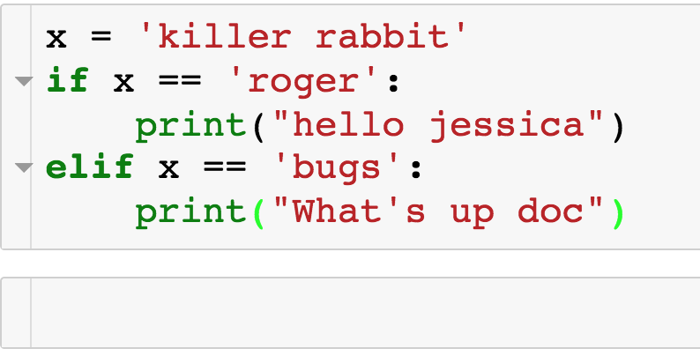
If + Elif + Else Statement
We can just have an if + elif, with no else:

Slide 19
If + Elif + Else Statement
We can just have an if + elif, with no else:
Nothing is printed since neither if not elif condition is true

Slide 20
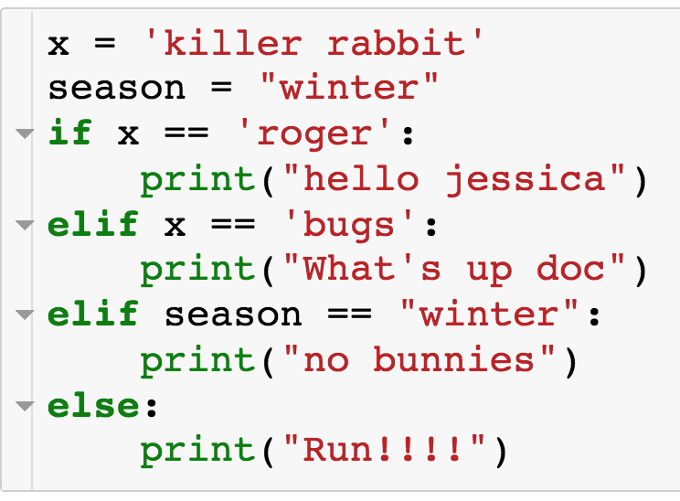
If + Elif + Else Statement
Example with multiple elif conditions:

Slide 21
If + Elif + Else Statement
Example with multiple elif conditions:

Slide 22
If + Elif + Else Statement
Example with multiple elif conditions:

Slide 23
If + Elif + Else Statement
Example with multiple elif conditions:

Slide 24

If + Elif + Else Statement
Example with multiple elif conditions:

Slide 25
If + Elif + Else Statement
Example with multiple elif conditions:

Slide 26
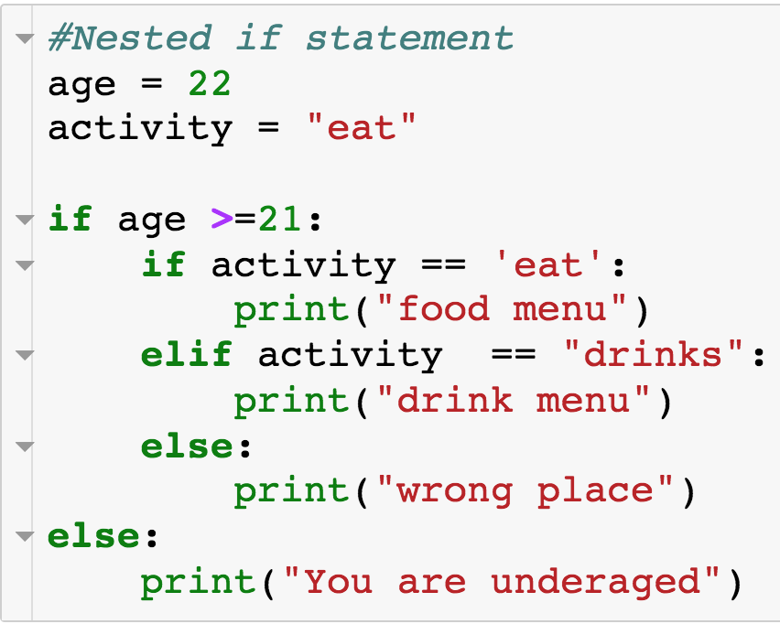
Nested Conditionals
We can have if statements nested within if statements:

Slide 27
Nested Conditionals
We can have if statements nested within if statements:

Slide 28
Nested Conditionals
We can have if statements nested within if statements:

Slide 29
Nested Conditionals
We can have if statements nested within if statements:

Slide 30

Nested Conditionals
We can have if statements nested within if statements:

Slide 31
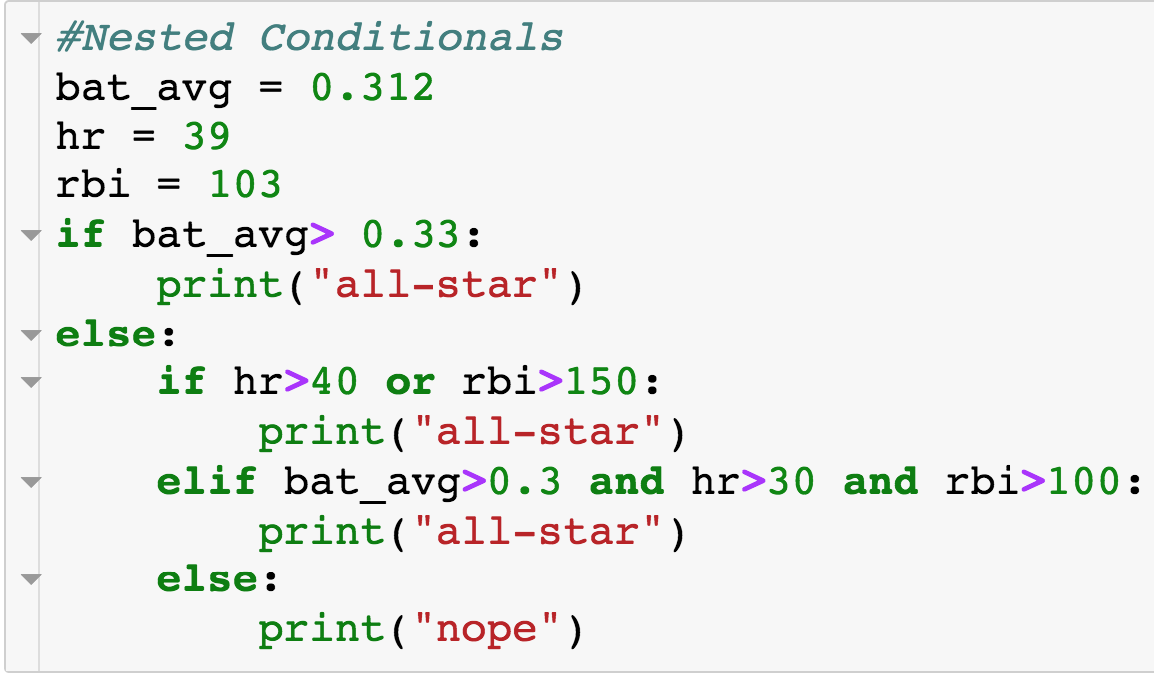
Nested Conditionals

Slide 32

Nested Conditionals

Slide 33
Specifying Multiple Conditions
How do you specify multiple conditions in a conditional statements?

Slide 34
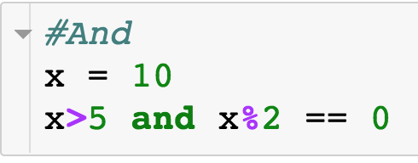
Specifying Multiple Conditions - and
How do you specify multiple conditions in a conditional statements?
Condition 1
Condition 2
Conditional statements w/ “and”

Slide 35
Specifying Multiple Conditions - and
How do you specify multiple conditions in a conditional statements?
Condition 1
Condition 2
AND
All conditions must evaluate to True
Can have arbitrary number of conditions

Slide 36
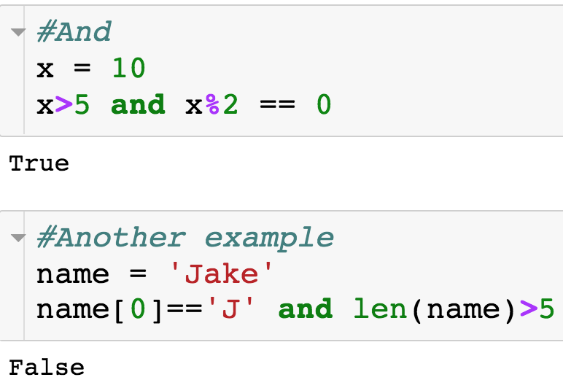
Specifying Multiple Conditions - and
How do you specify multiple conditions in a conditional statements?

Slide 37
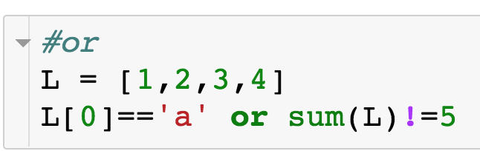
Specifying Multiple Conditions - or
How do you specify multiple conditions in a conditional statements?
Condition 1
Condition 2
Conditional statements w/ “or”

Slide 38
Specifying Multiple Conditions - or
How do you specify multiple conditions in a conditional statements?
Condition 1
Condition 2
OR
At least one condition must evaluate to True
Can have arbitrary number of conditions

Slide 39
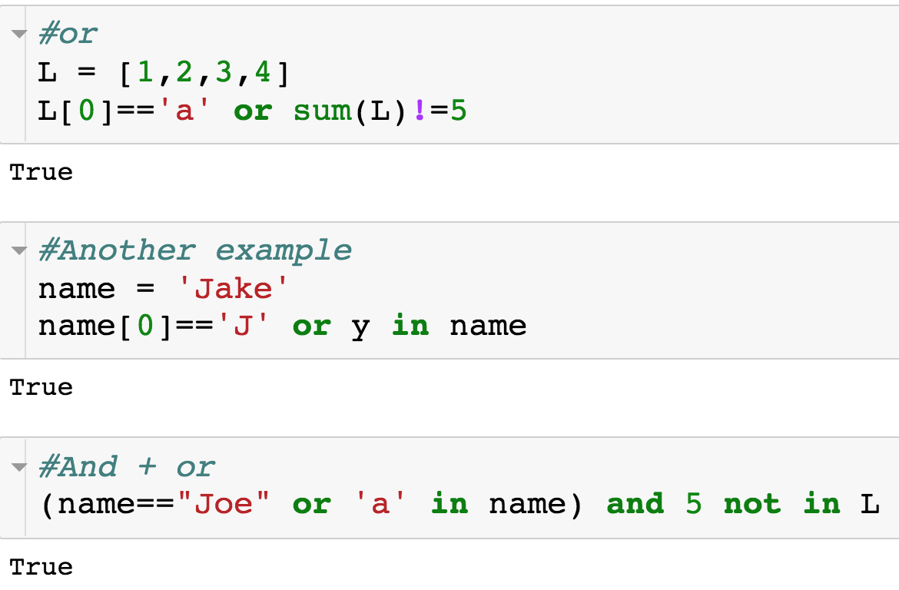
Specifying Multiple Conditions
How do you specify multiple conditions in a conditional statements?

Slide 40
For Loops
Use cases of for loops:
Iterate over the elements of a list or string
For each element, perform some sort of operation - count or sum
Perform some action a specified number of times
Deal out 5 cards
Have a student go through all 100 lockers

Slide 41
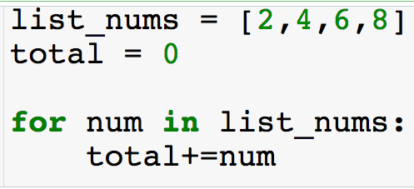
For Loops w/ List
Compute sum of elements of a list
Use for loop to iterate over the elements of the list

Slide 42
For Loops w/ List
Compute sum of elements of a list
Use for loop to iterate over the elements of the list
Keyword “for”
Loop variable – takes on each value of loop target
Loop target – object to be iterated over

Slide 43
For Loops w/ List
Can call loop variable whatever you want
Block of code to run each iteration of for loop

Slide 44
For Loops w/ List

Slide 45
For Loops w/ List

Slide 46
For Loops w/ List

Slide 47
For Loops w/ List

Slide 48
For Loops w/ List

Slide 49
For Loops w/ List

Slide 50
For Loops w/ List

Slide 51
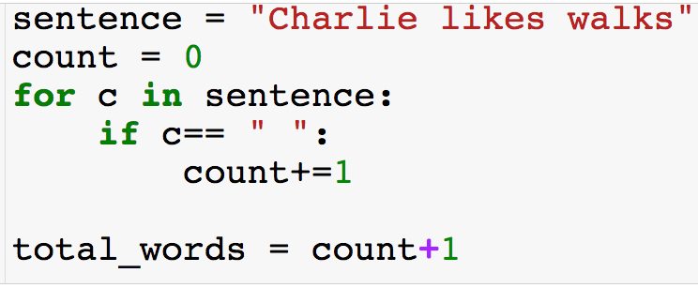
For Loops w/ Strings
Now the loop target is a string
Compute the number of words in sentence

Slide 52
For Loops w/ Strings

Slide 53
For Loops w/ Strings

Slide 54
For Loops w/ Strings

Slide 55
For Loops w/ Strings

Slide 56
For Loops w/ Strings
…

Slide 57
For Loops w/ Strings

Slide 58
For Loops w/ Strings

Slide 59
For Loops w/ Strings

Slide 60
For Loops w/ Strings

Slide 61
For Loops w/ Strings

Slide 62
Summary: For Loops w/ Strings or Lists
The loop target can be a string or a list
If the loop target is a list – iterate over the elements of the list by increasing index
If the loop target is a string – iterate over the characters of the string by increasing index
We will see other python objects that can be loop for targets

Slide 63
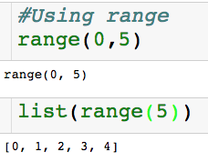
Range
start (defaults to 0 if left off)
end (non-inclusive)
Built-in range function

Slide 64
Range
start (defaults to 0 if left off)
end (non-inclusive)
Built-in range function
Can use range(0,n) as loop target
Need consecutive integers
Need to repeat something n times

Slide 65
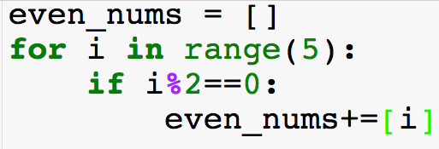
For Loops w/ Range
Using range() as loop target to get consecutive integers
Compute even numbers >=0

Slide 66
For Loops w/ Range

Slide 67
For Loops w/ Range

Slide 68
For Loops w/ Range

Slide 69
For Loops w/ Range

Slide 70
For Loops w/ Range

Slide 71
For Loops w/ Range

Slide 72
For Loops w/ Range

Slide 73
For Loops w/ Range

Slide 74
For Loops w/ Range

Slide 75
For Loops w/ Range
Using range() as loop target to do something n times.
Loop variables will not be used
Get n random samples of U[0,1]

Slide 76
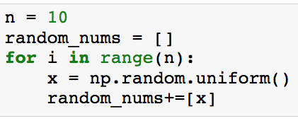
For Loops w/ Range
Using range() as loop target to do something n times.
Loop variables will not be used
Get n random samples of U[0,1]
Loop will run n times

Slide 77
For Loops w/ Range
Using range() as loop target to do something n times.
Loop variables will not be used
Get n random samples of U[0,1]
Loop will run n times
Generates U[0,1]

Slide 78
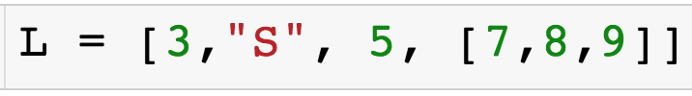
For Loops w/ Range
How do I iterate over the indices of a list using a for loop?

Slide 79
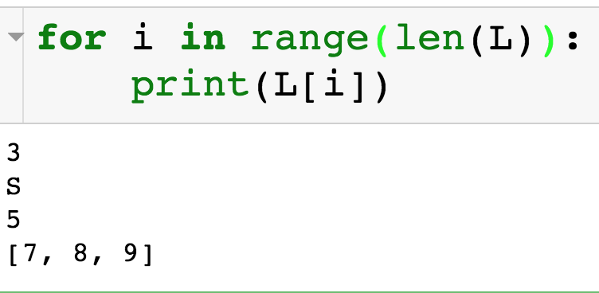
For Loops w/ Range
How do I iterate over the indices of a list using a for loop?

Slide 80
For Loops w/ Range
How do I iterate over the indices of a list using a for loop?
Why would I ever need to do this?

Slide 81
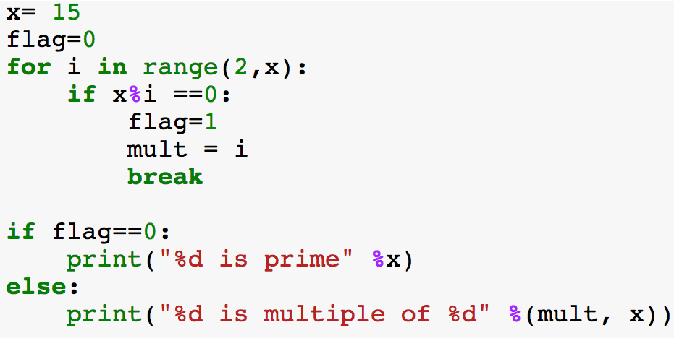
Break Statement
Jump out of nearest loop
Check if x is prime – just need to find one factor

Slide 82
Break Statement

Slide 83
Break Statement

Slide 84
Break Statement

Slide 85
Break Statement

Slide 86
Break Statement

Slide 87
Break Statement

Slide 88
Break Statement

Slide 89
Break Statement

Slide 90
Break Statement

Slide 91
Break Statement
Output: “3 is multiple of 15”

